Slide 1
Welcome Back
Jamie Zhang

Slide 2
Some changes in Syllabus
In Paper 2, candidates are expected to write solutions to given problems using the methods and concepts listed in topics 7 to 10.
Where the solution to a problem involves coding, candidates are required to write solutions in pseudocode. Solutions written in programming code will not be awarded marks. The exception is the 15-mark scenario question.
In the 15-mark scenario question, candidates are required to write solutions to the given problem using pseudocode or their choice of one of the following programming languages: Python, Visual Basic or Java. Solutions written in other programming languages will not be awarded marks

Slide 3
Game of this semester
Every week, there will be a game session to do a review.
The one who win the game session will be given a level-2 reward and moved out of the pool. And then, I will randomly pick one student to do a review class in Friday.
The class should be 1. Mainly English 2. including questions& activities.
The other students will give score to the class.

Slide 4
Vocab Check
I will pick up one day per week to do the vocab check
You need to be able to spell the words and give the definition(not necessarily be the same as the definition in the textbook)
The last two students will get extra HW during weekends
All correct, then no HW for all students during weekends

Slide 5
Review of Chapter I
How to pronounce three types of number systems, and what’s their base.
Why do we use _____ and ______?
Where do we use ____ in computer network?

Slide 6
Review of Chapter I
What’s the difference between IPv4 and IPv6?
What’s MAC Address?
What’s the difference between MAC Address and IP address?
How to represent color in HTML?

Slide 7
Review of Chapter I
To binary:
312 139 AF2 80C
To Hexadecimal:
0101001101 01001001 298 320
To Denary:
10110010 010010 AC2 2B

Slide 8
Review of Chapter I
Addition:
10100010+11011010
01011010 logical shift left for 2 bits and right for 4 bits. What’s the result?
Two’s Complement:
-49

Slide 9
Review of Chapter I
What’s ASCII code, and what’s the disadvantage?
What’s the difference between ASCII & Unicode

Slide 10
Review of Chapter I
Sound in real world?
Explain how sound is captured and stored in Computer？
What are the factors that will influence the file size and quality of a sound file?

Slide 11
Review of Chapter I
Sound as an Analog Signal: Sound in the real world is an analog signal, meaning it is continuous, with varying frequencies and amplitudes (e.g., voice, music, etc.).
Microphone: To capture sound, a microphone is used. It converts the sound waves (vibrations in the air) into an analog electrical signal.
Analog-to-Digital Conversion (ADC): The analog signal produced by the microphone is then converted into a digital signal using an Analog-to-Digital Converter (ADC).
Sampling: The ADC takes samples of the continuous analog signal at regular intervals (known as the sampling rate). This converts the continuous sound wave into discrete data points.
Digital Representation: Once the sound is converted to a digital signal, it is represented as a series of binary numbers (0s and 1s), which can be stored in a computer's memory.
File Format: The digital sound is saved in various audio file formats, such as WAV, MP3, or FLAC.

Slide 12
Review of Chapter I
How are images stored in Computer？
What are the factors that will influence the file size and quality of an image file?

Slide 13
Review of Chapter I
Data storage
How to calculate the file size of image/sound files?

Slide 14
Review of Chapter I
A stereo audio file has the following characteristics:
Sampling rate: 44,100 Hz
Bit depth: 16
Length of the audio file: 3 minutes
What’s the file size in KB

Slide 15
Review of Chapter I
Lossless & Lossy Compression?
What’s RLE: RLE (Run-Length Encoding) is a simple form of data compression technique where consecutive repeated elements (or runs) are stored as a single value and a count.
MP3/MP4/JPG/PNG

Slide 16
Review of Chapter II
Data sent over long distances is usually broken up into ______, which includes __,__ and ___
____ includes ______
____ includes ______
____includes _______
How the packets are transmitted in the network? via?

Slide 17
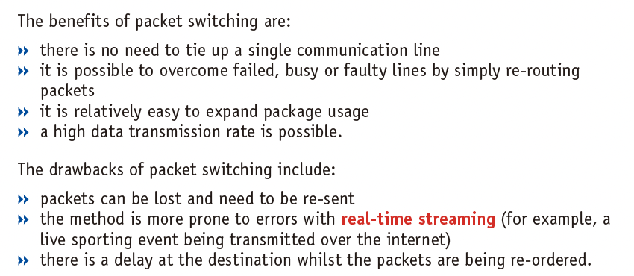
Review of Chapter II

Slide 18
Review of Chapter II
What’s hopping number?
Data transmission directions?
How many bits can be sent at the same time?
Where are ___ and ___ commonly used?

Slide 19
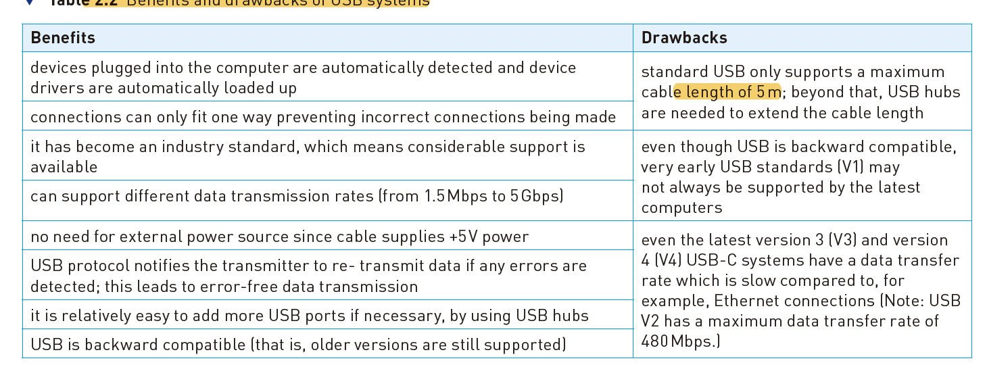
Review of Chapter II

Slide 20
Review of Chapter II
Where could data transmission problem occur?
What are the error detection methods?
What’s ARQs?
Draw a graph of encryption.
What’s the difference between Symmetric and Asymmetric encryption?

